Slide 1
Chapter 9
The Linear Model (Regression)

Slide 2
What is the Linear Model?
A way of predicting the value of one variable from another.
  It is a hypothetical model of the relationship between two variables.
  The model used is a linear one.
  Therefore, we describe the relationship using the equation of a straight line.

Slide 3

Describing a Straight Line
$$Y_{i}=\left(b_{0}+b_{1}X_{i}\right)+ε_{i}$$
b_{i}
  Coefficient for the predictor
  Gradient (slope) of the line
  Direction/strength of relationship
b₀
  Intercept (value of Y when X = 0)
  Point at which the regression line crosses the Y-axis (ordinate)

Slide 4
A Musical Example
A record company boss was interested in predicting album sales from advertising.
Data
  200 different album releases
Outcome variable:
  Sales (CDs and downloads) in the week after release
Predictor variables
  The amount (in £s) spent promoting the album before release
  Number of plays on the radio
  Image of the band.

Slide 5
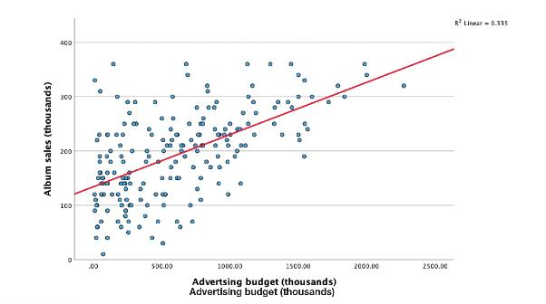
Linear Model with One Predictor

Slide 6
b₀
b₀ is the intercept (y intercept)
The intercept is the value of the Y variable when all Xs = 0.
This is the point at which the model plane crosses the Y-axis (vertical).

Slide 7
Beta Values
b₁ is the coefficient for variable 1 (advertising budget).
You can have linear models with many predicters
  b₂ is the coefficient for variable 2.
  b_{n} is the coefficient for n^{th} variable.

Slide 8
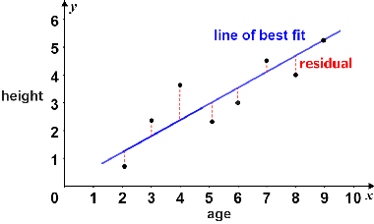
The line of Best Fit

Slide 9
Linear Regression
Regression can be used to predict new scores
  Take the test scores (x), plug into the formula, and generate a y score for each individual.
  Does mean y differ between groups?
  Are some variables better predictors for some groups than others?
Notes:
Assumption of regression analysis: There is a linear relationship between test scores and criterion scores.
Formula for straight line:
Ĉ = a + b(T) where:
Ĉ is the predicted training criterion score for an individual training candidate,
a is the intercept,
b is the regression coefficient or slope, and
T is an individual’s aptitude test score.
This formula can be used to predict criterion scores from test scores.
Use of software packages: We can use software packages such as SPSS and SAS to conduct the regression analysis, which produces values of a and b.
Evaluating predictive ability of the test: This is done by taking any individual’s score on the test (T), plugging it into the regression equation, and calculating a predicted score on the criterion (Ĉ) for that individual.

Slide 10
The Fit of the Model?
The model based on the data might not reflect reality.
  We need some way of testing how well the model fits the observed data.
  How?
    F (remember F from ANOVAs?)
    R² (Coefficient of Determination)

Slide 11
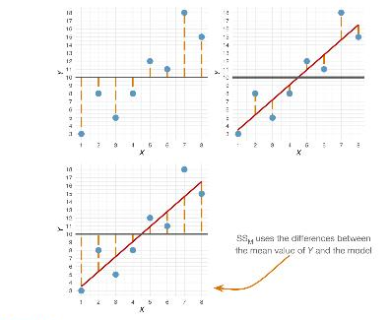
Sums of Squares
Notes:
SST uses the variances between the observed data and the mean Y
SSR uses the difference between the observed and the model
SSM uses the difference between the model and the mean Y

Slide 12
Summary
SS_{T}
  Total variability (variability between scores and the mean).
SS_{R}
  Residual/error variability (variability between the model and the actual data).
SS_{M}
  Model variability (difference in variability between the model and the mean).

Slide 13
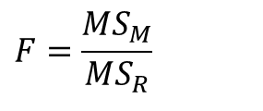
Testing the Fit: F-Statistic
Mean Squared Error
  Sums of Squares are total values.
  They can be expressed as averages (divide by df).
  These are called Mean Squares, MS
$$F=\frac{MS_{M}}{MS_{R}}$$

Slide 14
R and R²
R
  The correlation between the observed values of the outcome, and the values predicted by the model.
R²
  The proportion of variance accounted for by the model.
Adj. R²
  An estimate of R² in the population (shrinkage).

Slide 15
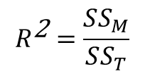
Testing the Fit: R²
R²
  The proportion of variance accounted for by the regression model.
  The Pearson correlation coefficient squared
$$R^{\text{2}}=\frac{SS_{M}}{SS_{T}}$$

Slide 16
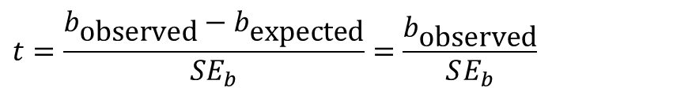
Individual Predictors
$$t=\frac{b_{\text{observed}}−b_{\text{expected}}}{SE_{b}}=\frac{b_{\text{observed}}}{SE_{b}}$$

Slide 17
How Well Does the Model Fit the Data?
There are two ways to assess the accuracy of the model in the sample:
Residual statistics
  Standardized residuals
Influential cases
  Cook’s distance (how much influence does a single datapoint have on the model?)

Slide 18
Standardized Residuals
In an average sample, 95% of standardized residuals should lie between ± 2.
99% of standardized residuals should lie between ± 2.5.
Outliers
  Any case for which the absolute value of the standardized residual is 3 or more is likely to be an outlier.

Slide 19
Generalizing the Model
We hope to be able to generalize the sample model to the entire population.
To do this, several assumptions must be met (Chapter 6)
Violating these assumptions stops us generalizing conclusions to our target population.

Slide 20
Straightforward Assumptions
Variable type:
  Outcome must be continuous.
  Predictors can be continuous or dichotomous.
Non-zero variance:
  Predictors must not have zero variance.
Linearity:
  The relationship we model is, in reality, linear.
Independence:
  All values of the outcome should come from a different person.

